Slide 1
CERAMICS I
Introduction

Slide 2
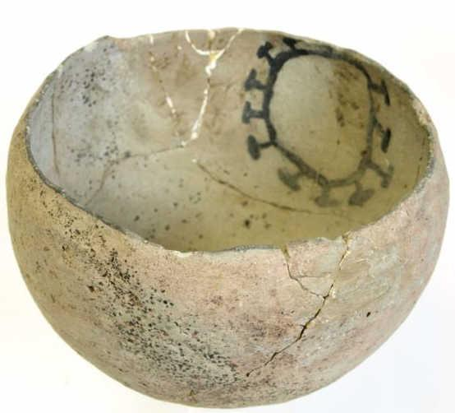
History
Pottery has been made by hand since prehistoric times.
Early uses were as functional vessels and figurative sculptures.
Clay was hardened
by baking in the sun.

Slide 3
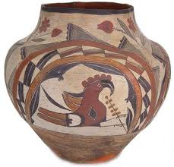
The discovery that fire hardened clay encouraged the development of more complex forms of pottery.
The manipulation of clay turned pottery into an art form.
This skill was passed from one generation to the next.

Slide 4
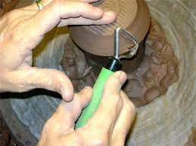
Tools
Hand building requires a variety of tools.

Slide 5
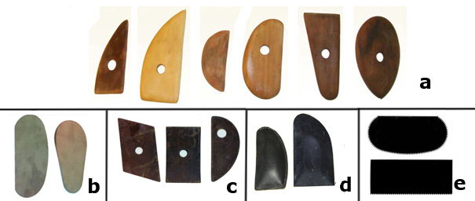
Rubber or metal kidneys come in a variety of shapes and sizes, thicknesses and shapes,
They can have serrated edges for paring down rough edges.
It is used to refine the clay surface.

Slide 6
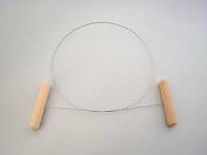
A potter’s needle can be used to pierce holes for decoration or the release of air.
A cutting wire is essential for wedging and cutting pots off a wheel head.

Slide 7
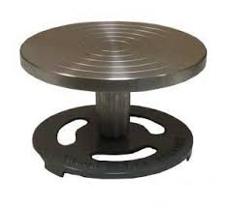
A bow harp is used to slice slabs of clay.
A banding wheel of turntable allows work to be rotated and viewed from all sides. This is particularly helpful when coiling.

Slide 8
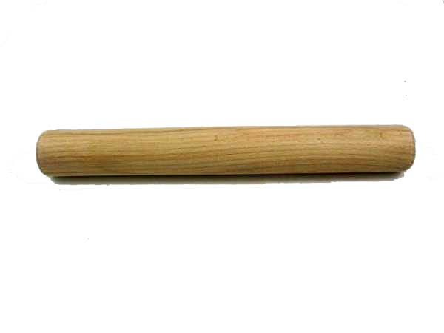
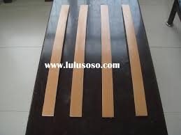
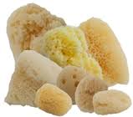
A rolling pin is used to stretch and flatten clay. They work best with no handles.
Roller guides help to roll clay into slabs of varying thicknesses.
Sponges are used to remove excess water from the inside and surface of pots, to remove rims, and to apply slip decoration.

Slide 9
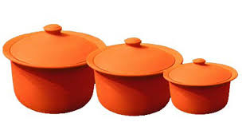
Types of Clay
Earthenware clays, also known as terracotta, is the most common naturally occurring clay. It’s high iron content makes it a rich, rusty color.

Slide 10
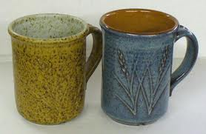
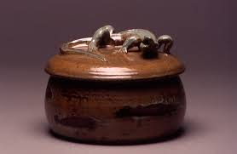
Stoneware clays are dense and hard when fired, and much stronger than earthenware. They are available in a number of colors ranging from white to brown.

Slide 11
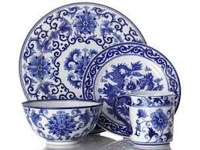
Porcelain is the whitest and purest of all clays and is capable of being fired at very high temperatures. Pots made with porcelain can remain unglazed to show their translucency.

Slide 12
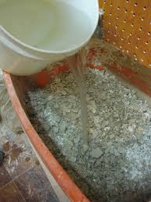
Working with Clay
Reclaiming clay Until it is fired clay can be reprocessed over and over again. It can be made back into a workable body. Clay never needs to be wasted.
Dried clay is broken into pieces and covered in warm water. It sits overnight and is worked back into blocks of clay.

Slide 13
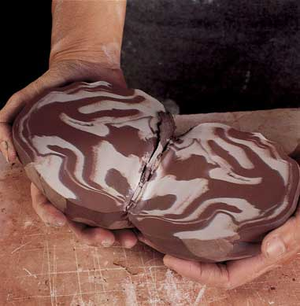
Wedging clay prepares the clay for building. It is a process of mixing the clay thoroughly and removing air bubbles. Clay types can be blended as can soft and hard layers to make the clay more workable.

Slide 14
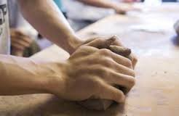
Kneading is essential to even out the clay and remove any air bubbles, which can cause explosions during firing.

Slide 15
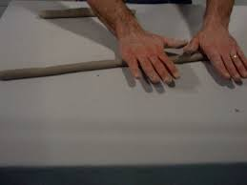
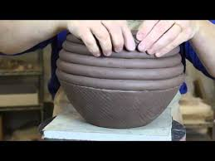
Pottery Techniques
Coiling is rolling clay into cylindrical strips and wound upwards to create the desired shape.

Slide 16
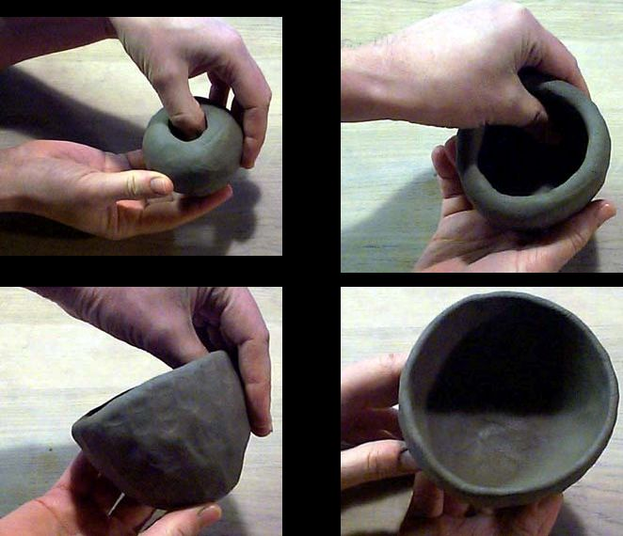
Pinching is a process that begins with a ball of clay. Thumbs are pushed into the center and then walls are created by pinching and turning the pot. The pot is then pushed on a flat surface to create a base.

Slide 17
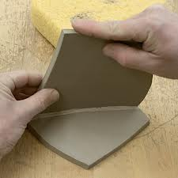
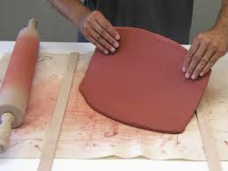
Slabbing is a technique in which soft or hard slabs of clay are used to create pots, boxes, or tiles. Slabs can be made with a rolling pin or slab roller.

Slide 18
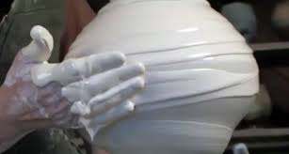
Thing-a-majigs and Whatchamacallits
Slip is a liquefied suspension of clay particles in water. It is usually the consistency of cream and is often used to help adhere decorations to a pot.

Slide 19
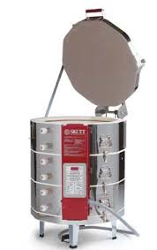
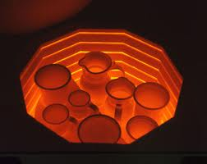
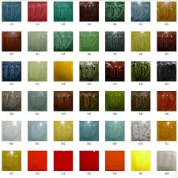
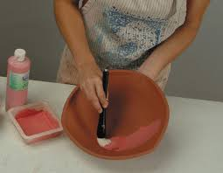
A kiln is an oven that is fired at high temperatures for hardening pottery.
Glaze is a layer or coating of a vitreous substance which has been fused to a ceramic object through firing. It can be used to color, decorate, strengthen, or waterproof an item.

