Slide 1
Impressionism
Playing with Light

Slide 2
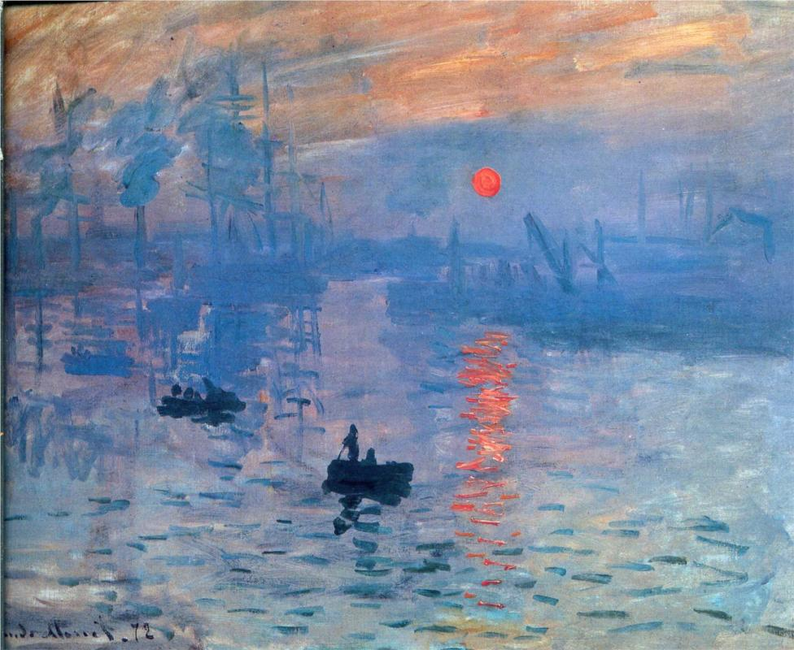
Impressionism was a Paris-based art movement that came to prominence in the 1870’s and 1880’s.
Impression, Sunrise is a painting by Claude Monet that gave rise
to the name of the Impressionist movement.

Slide 3
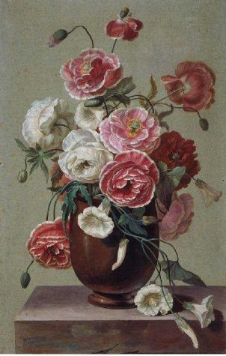
Up to this point, the art community in France mainly painted still life's, portraits, and landscapes in a studio.
Antoine Berjon Flowers in a Vase

Slide 4
Impressionists were considered radicals of their time. They violated rules of academic painting such as the Romantists.
They constructed their pictures from freely brushed colors that took precedence over lines and contours.

Slide 5
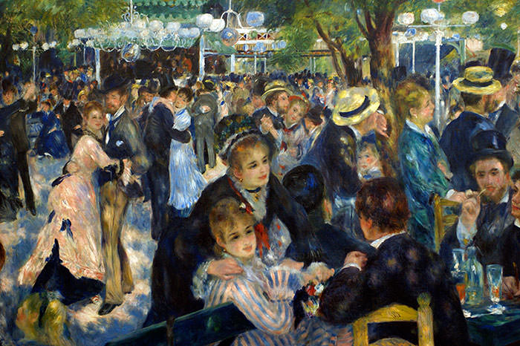
Impressionists painted realistic scenes of modern life, and often painted outdoors.
Dance at Le Moulin de la Galette Pierre-Auguste Renoir 1876

Slide 6
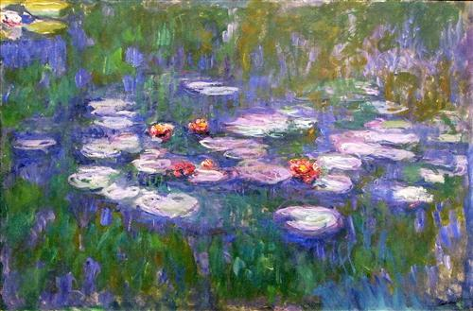
Impressionists found that they could capture the momentary and transient effects of sunlight by painting en plein air (outdoors).
Water Lilies, Claude Monet

Slide 7
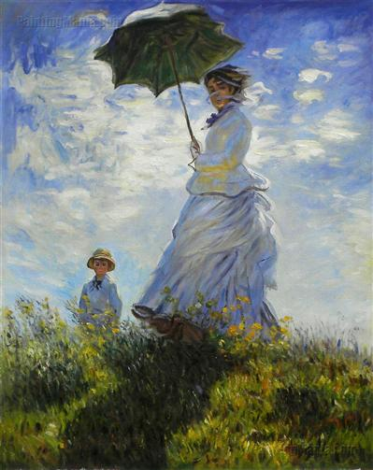
They portrayed overall visual effects instead of details, and used short “broken” brush strokes of mixed and pure unmixed colour~ not blended smoothly or shaded smoothly.
They emphasized the intensity of color and the movement of light.
Claude Monet, Woman with a Parasol- Madame Monet and Her Son 1875

Slide 8
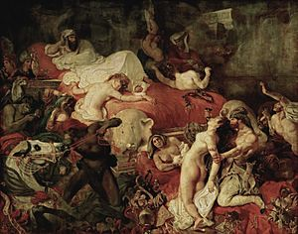
Impressionism followed the art movements of the Romantics (early 19th century) and the Realists (mid 19th century).
Romantics emphasized
emotion within exotic
subject matter.
Eugene Delacroix, Death of Sardanapalus 1827

Slide 9
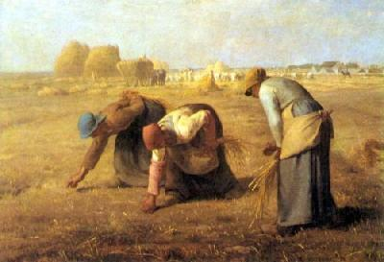
The Realists attempted to portray real people of all classes in situations that arise in everyday life with “truth and accuracy.”
Jean-Francois Millet, The Gleaners 1857

Slide 10
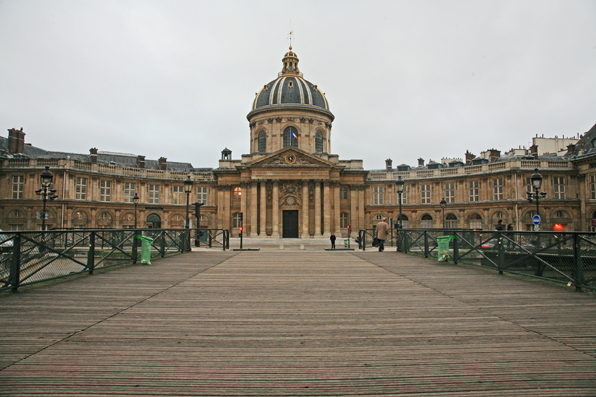
French Art was dominated by the Academie des Beaux-Arts
in the middle of the 19th century. They sponsored a juried
art show called the Salon de Paris. The Salon rejected many
of the Impressionists’ works because their style was so different than
the status quo.

Slide 11
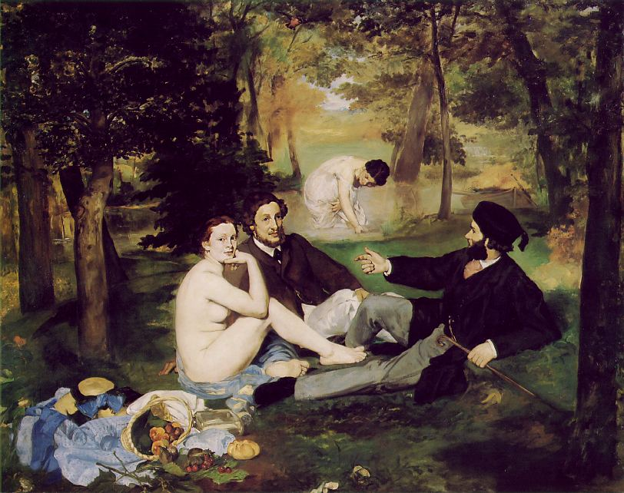
One of the rejected paintings was Edouard Manet’s, The
Luncheon on the Grass 1863. It was rejected primarily because
it depicted a nude woman and two clothed men at a picnic.
Ironically, the jury usually accepted nudes in historical and allegor-
ical paintings. They frowned on Manet placing a nude in a
contemporary setting.

Slide 12
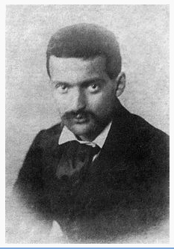
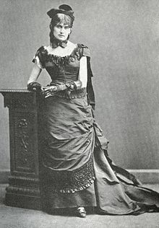
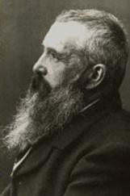
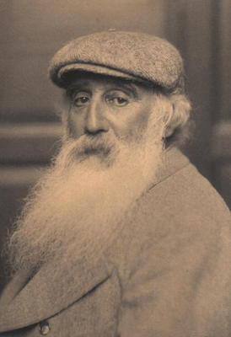
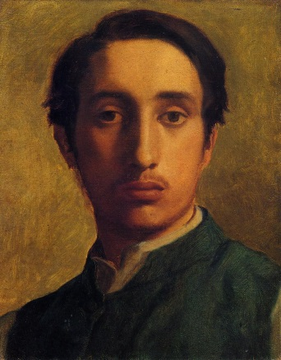
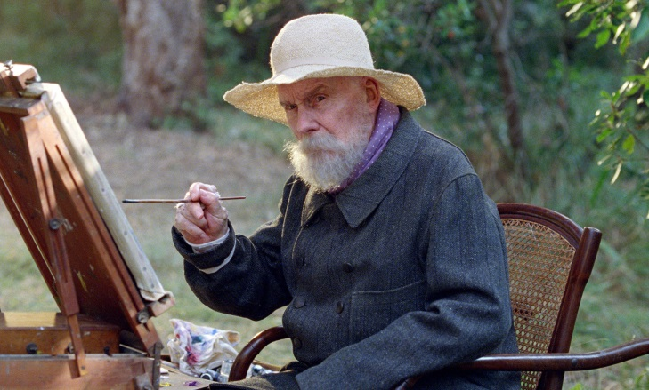
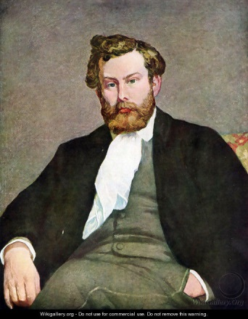
Claude Monet
Paul Cezanne
Berthe Morisot
Camille Pissaro
Edgar Degas
Pierre-Auguste Renoir
Alfred Sisley
The young artists founded their own association to be able to exhibit their artworks independently.

Slide 13
Impressionism grew in popularity in Europe and
eventually inspired American artists to paint in the same
style. Today, the works of the Impressionists are one
of the most recognizable in popular culture.
Some of the most famous Impressionists and their
paintings are:

Slide 14
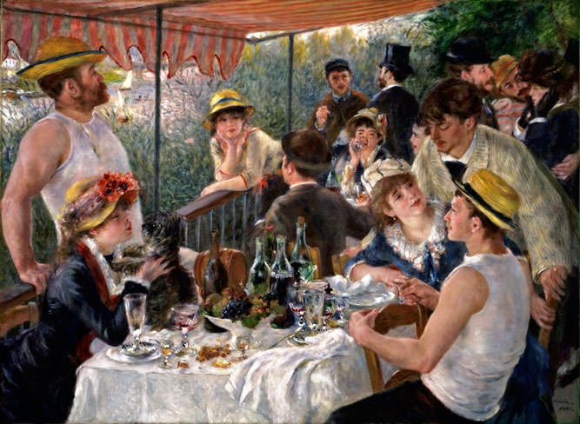
Pierre – Auguste Renoir
(1841 – 1919)
Had a fascination for painting the human form
Eventually rejected Impressionism
Wanted to apply more formal techniques to portraits and figure paintings
Luncheon of the Boating Party Pierre Auguste - Renoir 1881

Slide 15
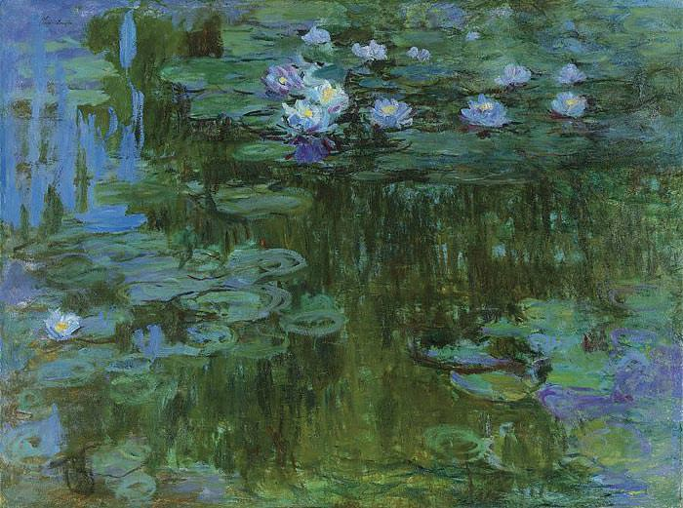
Claude Monet
(1840 – 1926)
Used broken color and rapid brushstrokes
The name of the movement came from his painting Impression Sunrise
Water Lilies Claude Monet

Slide 16
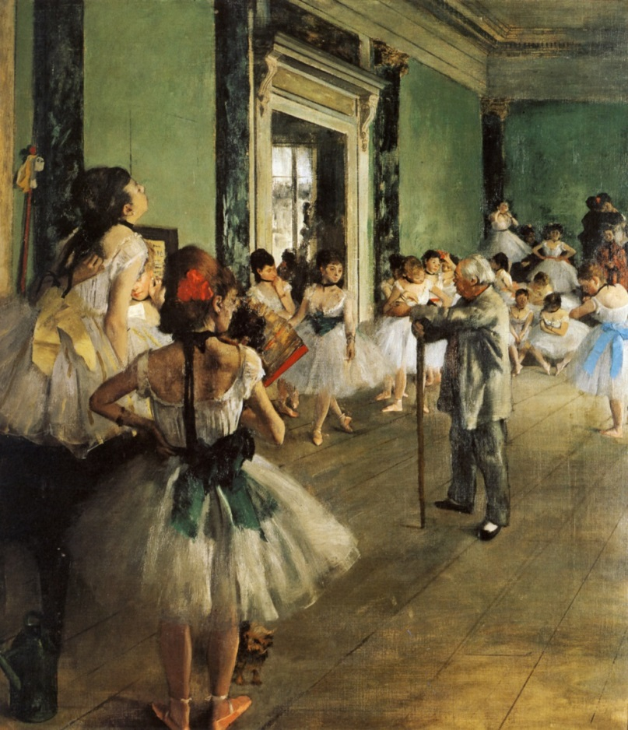
Edgar Degas
(1834 – 1917)
Stressed movement, expression, and the harmony of line
Most identified with subject matter of ballerinas and horse races
The Dancing Class Edgar Degas 1870

Slide 17
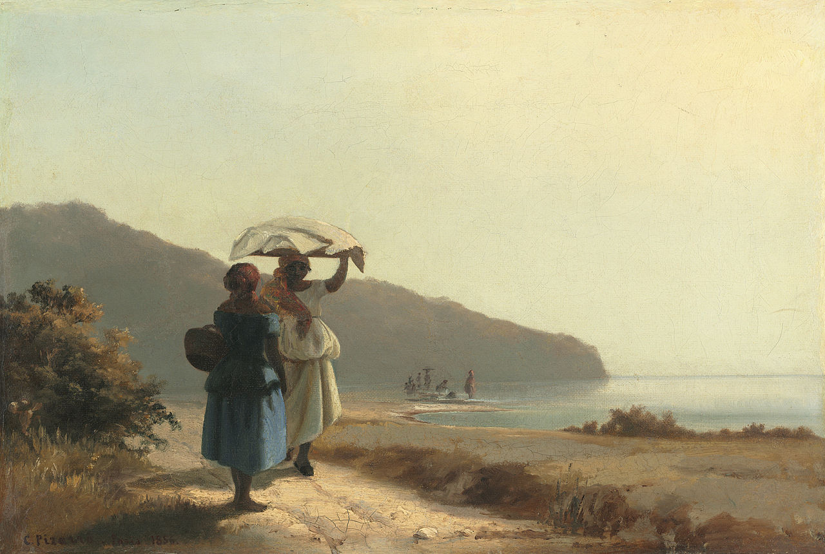
Camille Pissaro
(1830 – 1903)
As the oldest of the group, he was called the “dean of Impressionist painters”
Insisted on painting individuals in natural settings without “artifice or grandeur”
Two Women Chatting by the Sea Camille Pissaro 1856

Slide 18
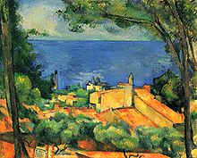
Paul Cezanne
(1839 – 1906)
Interested in simplifying natural forms to geometric shapes
Influential toward the modern movement of Cubism
L’Estaque Paul Cezanne 1885

Slide 19
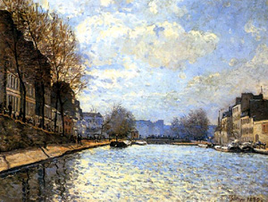
Alfred Sisley
(1839 – 1899)
Concentrated on landscape painting more consistently than any other Impressionist
Described as having an “impersonal textbook idea of a perfect Impressionist painting.”
Known for his “impressive” skies
View of Canal Saint-Martin Alfred Sisley 1870

Slide 20
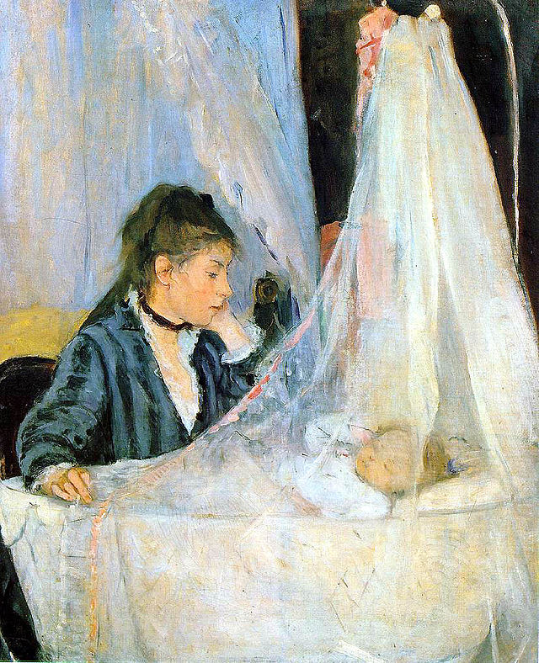
Berthe Morisot
(1841 – 1895)
Her paintings reflect 19th century cultural restrictions of class and gender
Focused on domestic life and portraits
The Cradle Berthe Morisot 1872

Slide 21
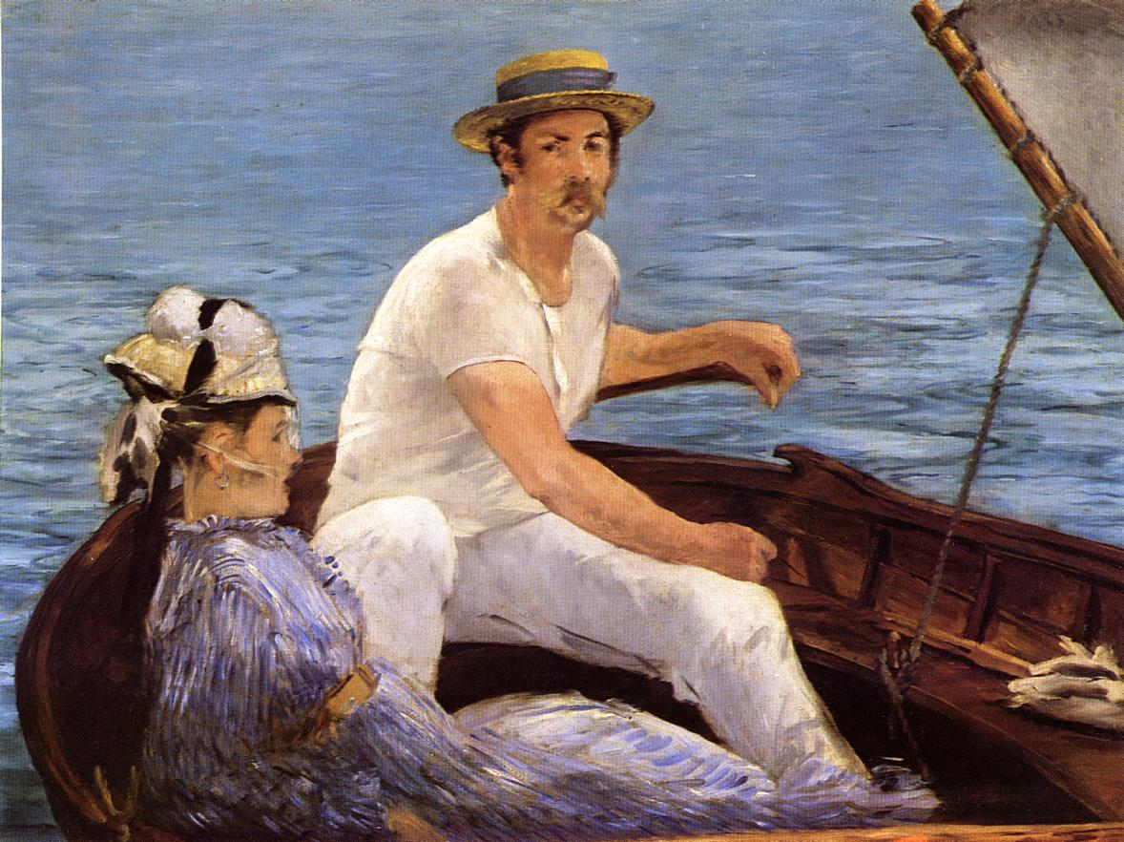
Edouard Manet
(1832 – 1883)
His painting Luncheon on the Grass helped inspire Impressionism
He painted the social life in 19th century Paris
Boating Edouard Manet 1874

Slide 22
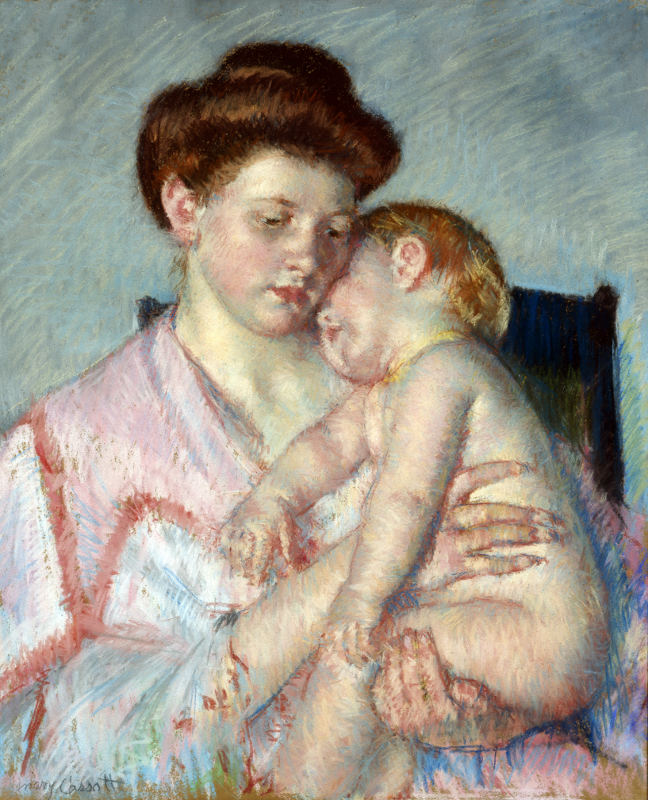
Mary Cassatt
(1844 – 1926)
Most identified with subject matter of mother and child
Interested in gesture through immediate observation
Born in the United States
Sleepy Baby Mary Cassat 1910

Slide 23
Post – Impressionist Painters
Extended Impressionism while rejecting its limitations
They were dissatisfied with the triviality of subject
matter and the loss of structure in Impressionist paintings.
They were not in agreement concerning a cohesive movement.
“The movement ushered in an era during which painting transcended its traditional role as a window onto the world and instead became a window into the artist's mind and soul.”

Slide 24
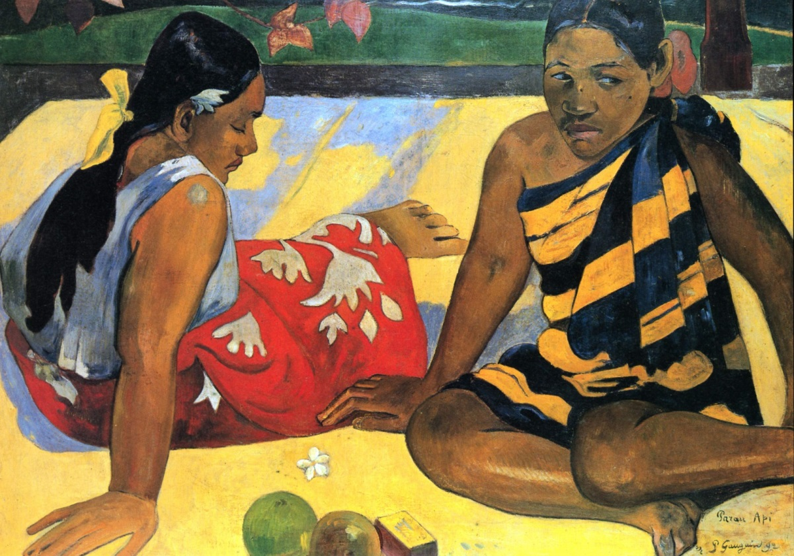
Paul Gauguin
(1848 – 1903)
Painted exaggerated body proportions
Painted using geometric designs and stark contrasts
Most famous for painting tropical island scenes
Tahitian Women on the Beach Paul Gauguin 1892

Slide 25
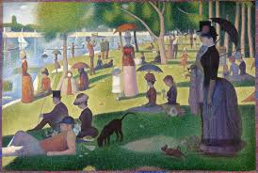
Georges Seurat
(1859 – 1891)
Most famous for Post – Impressionist style of Pointillism (painting with dots of color)
Believed certain emotions could be provoked by using luminous colors
A Sunday Afternoon on the Island of La Grande Jatte Georges Seurat 1884–1886

Slide 26
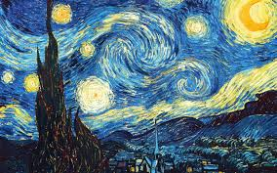
Vincent Van Gogh
( 1853 – 1890)
Was born in the Netherlands (Dutch)
Mental illness often interfered with his work
Most of his paintings share the characteristic of vivid color
“The Starry Night” Vincent Van Gogh 1889

Slide 27
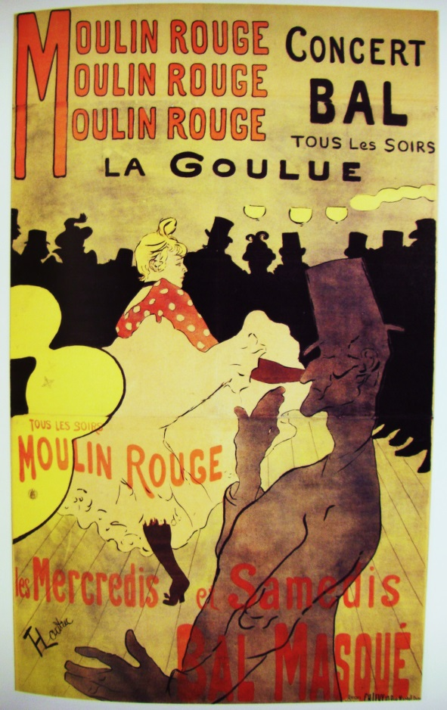
Henri de Toulouse – Lautrec
(1864 – 1901)
Style was swift sketches expanded into brightly colored paintings
Favorite subject matter was dance halls and nightclubs of Paris
Alcoholism plagued him throughout most of his life
“Moulin Rouge” Henri Toulouse-Lautrec 1891

