Slide 1
Introduction to Art Ch. 7: Texture
The way the surface of an object feels to the touch.
(rough, smooth, grainy, slick, gritty)
Texture in our everyday lives is very important
Atmosphere in a restaurant depends partly on texture
Texture of food can affect our likes/dislikes
Texture of clothing can affect what we like to wear

Slide 2
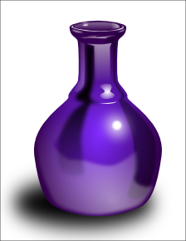
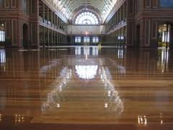
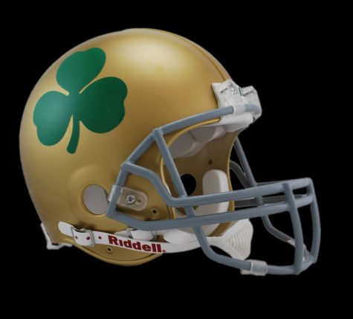
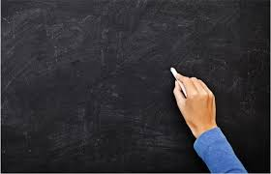
Common textures in art:
Glossy – slick and shiny
Matte – smooth but not slippery or shiny

Slide 3
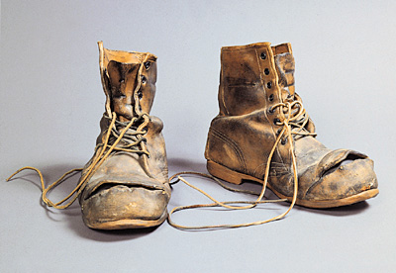
Actual Textures Occur in real objects that you can touch (tactile sense)
Nitro by Marilyn Levine 1994
Boots with Steel Toes
by Marilyn Levine 1971

Slide 4
Tactile Memories
Help us sense textures by looking at them
Do not have to touch something to sense texture

Slide 5
Simulated Textures Texture in artwork that can be seen but not touched, as distinguished from the actual texture itself
Migrant Mother by Dorothea Lange 1936

Slide 6
Invented Textures Created by artists but not intended to resemble textures you find in real life
The Starry Night by Vincent Van Gogh 1889

Slide 7
Some artworks use both simulated and actual textures
Oysters by Edouard Manet 1862
Texture of oysters and lemons appeals to sense of sight (simulated)
Texture of thick strokes of paint used to create oysters appeals
to sense of touch (actual)

Slide 8
Artists use texture for various reasons:
To define shapes
To provide variety
To create interesting surfaces
To help viewers recognize objects

