Slide 1
Surrealism
Dream or Reality

Slide 2
Surrealism
Began in the early 1920s
Developed out of the Dada Movement after WWI
Mocked materialistic and nationalistic attitudes
Against middle class complacency
Anti-war
Best known for visual artworks and writings

Slide 3
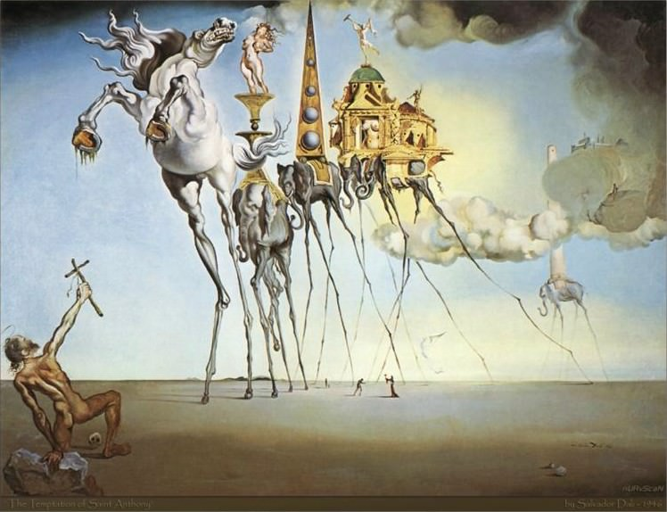
Features the element of surprise
Depicted unlike things next to each other
Unnerving, illogical scenes
Strange creatures created from everyday objects
The Temptation of St. Anthony by Salvador Dali

Slide 4
Attempted to bridge dream and reality
Sought to channel the unconscious as a means to unlock the power of the imagination
Techniques became known as Automatism – expresses the actual functioning of thought
Allowed artists to forgo conscious thought and embrace chance when creating art

Slide 5
Sigmund Freud Founded Psychoanalysis
Profoundly influenced the Surrelists
He legitimized the importance of dreams and the unconscious as valid revelations of human emotion and desires
Brought attention to the inner worlds of sexuality, desire and violence

Slide 6
Sigmund Freud 1853 - 1939

Slide 7
Andre’ Breton Founder of Surrealism
He wrote the Surrealist Manifesto in 1924
Was called the Pope of Surrealism
French writer, poet, anarchist, and anti-fascist
Andre’ Breton 1896 - 1966

Slide 8
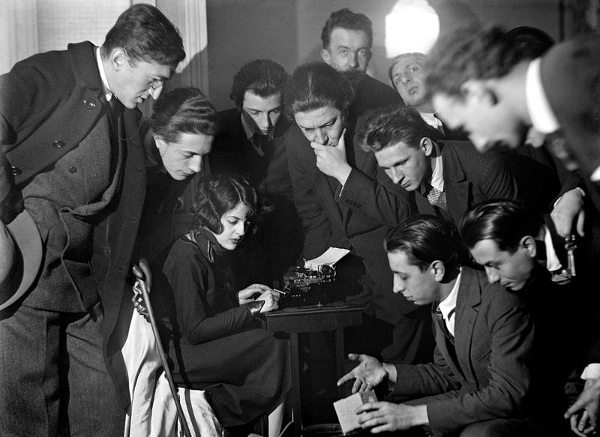
Bureau of Surrealist Research
Established in Paris in 1924
Group of artists and writers who conducted interviews of people about their dreams and social lives
Recording a waking
dream séance session

Slide 9
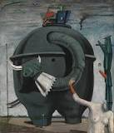
Surrealists draw upon dreams and unconscious mind
Imagery is outlandish and perplexing
Nature is the most frequently used imagery
The Elephant Celebes
By Max Ernst 1921

Slide 10
Surrealists use fantasy and dream imagery
They expose their inner minds in eccentric, symbolic ways
They used detail with the illusion of three-dimensionality
They emphasized dream-like quality

Slide 11
The Persistance of Memory
By Salvador Dali

Slide 12
The Son of Man
By Rene’ Magrite

Slide 13
Nauka Chodzenia by Jacek Yerka

Slide 14
Above the Trees by Vladimir Kush

Slide 15
Metamorphosis by Vladimir Kush

Slide 16
African Sonata by Vladimir Kush

